Slide 1
UNICORN COMPANIES ANALYSIS
Abdullah Imran

Slide 2
About the Project
About the Data
Data Cleaning
Data Exploration Using SQL & Python
Data Visualization Dashboard
Web Page
CONTENTS

Slide 3
ABOUT THE PROJECT
This project provides insights into the characteristics of unicorn companies (companies whose values are over 1 billion dollars). In particular, it will find the answers to the different questions and visualize the results using different techniques

Slide 4
ABOUT THE DATA
The dataset used in this analysis contains records of 1074 unicorn companies
obtained from Maven Analytics' official website.
The sample size reduces to 1060 due to the lack of funding and inaccurate information on the year companies are found.
Microsoft Excel was used for the initial setup before importing to SQL server, then PowerBI for Visualization

Slide 5
DATA CLEANING
In this project, we mainly used SQL for both data cleaning and exploration.
Data cleaning steps include:
Check for duplicates
Rename columns where necessary
Standardize date format
Drop rows with errors
Reformat currency values (e.g., $2M => 2,000,000)
Generate new columns based on existing column values
Delete unused columns

Slide 6
DATA EXPLORATION
SQL skills used:
Joins
Common Table Expressions (CTEs),
Aggregate Functions
Data Types Conversion
Relational operators
Python skills used:
Skitlearn Libraries
Basic Concepts

Slide 7
NORMALIZATION

Slide 8
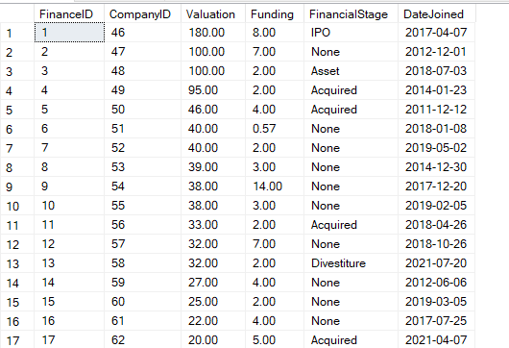

Slide 9
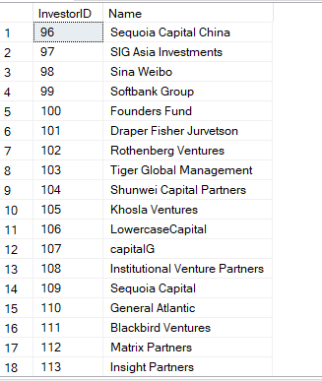
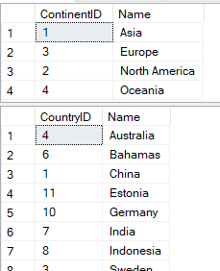

Slide 10
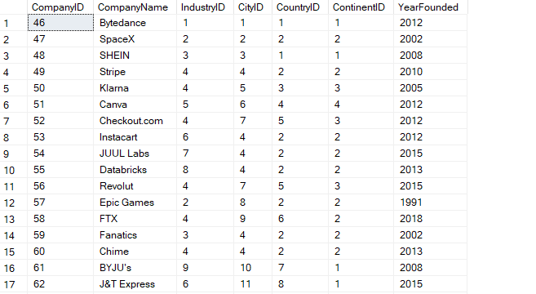

Slide 11
ERD DIAGRAMS

Slide 12
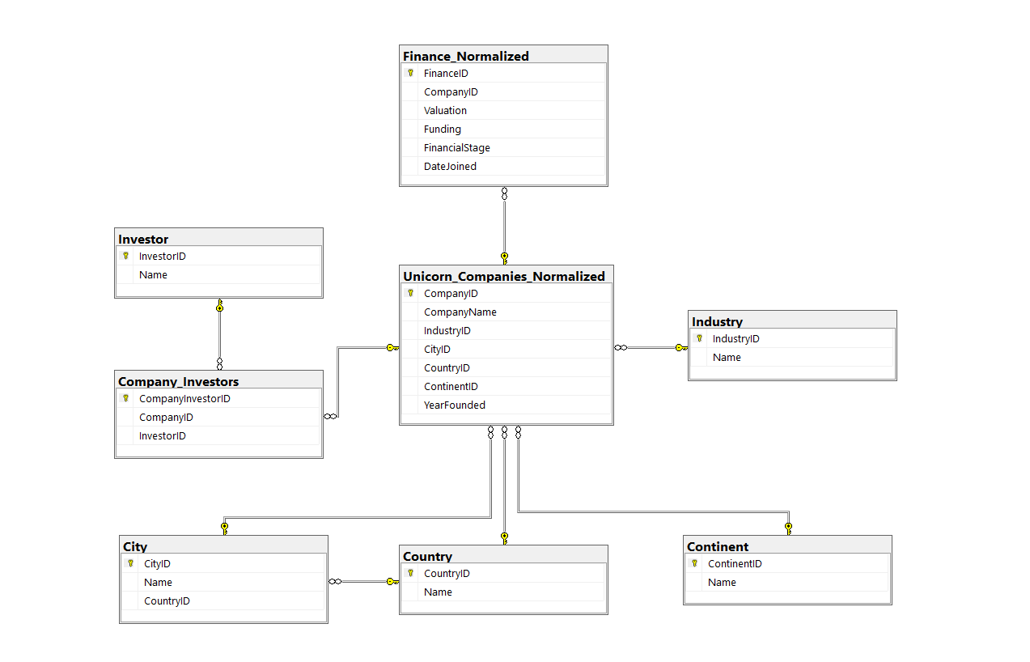

Slide 13
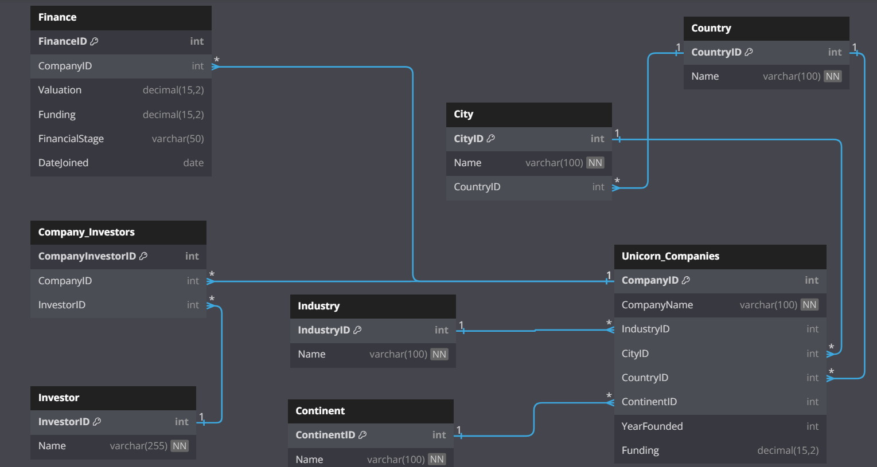

Slide 14
1. ANALYSIS USING SQL

Slide 15
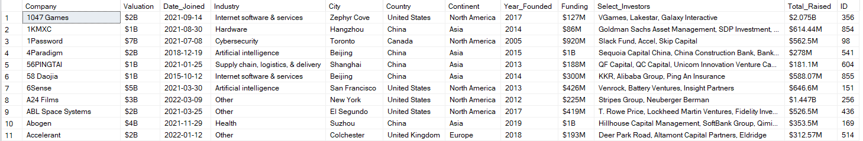
Unicorn Table

Slide 16
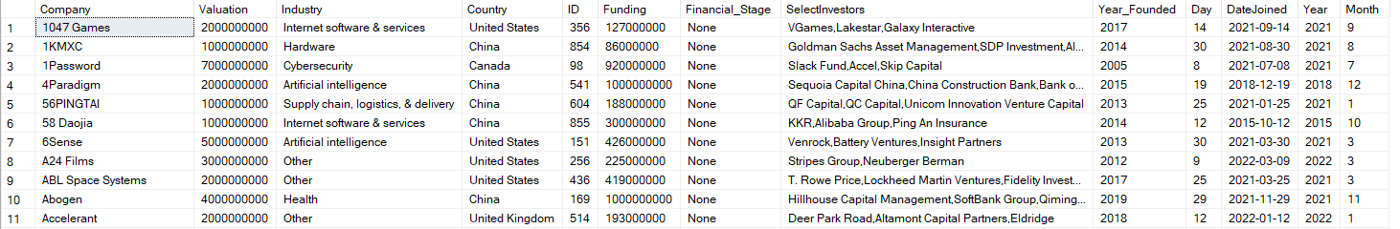
Table 2: Finance

Slide 17
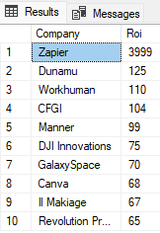
DATA EXPLORATION
1. Which unicorn companies have had the biggest return on investment (ROI)?
⇒ This query output shows the top 10 companies with the biggest ROI.
Zapier achieved the biggest ROI of 3999 percent
Dunamu comes second with 125 percent ROI
Workhuman is third with 110 percent ROI.
⇒ Zapier’s ROI is significantly high compared to other
companies.

Slide 18

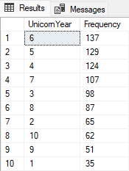
DATA EXPLORATION
2. How long does it usually take for a company to become
a unicorn?
⇒ On average, a company takes about 6 years to become a unicorn.
⇒ The majority of companies could become a unicorn
within 4 to 7 years.

Slide 19
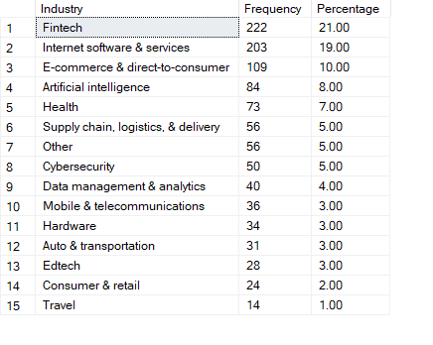
DATA EXPLORATION
3. Which industries have the most unicorns?
Fintech and Internet Software & Services have about 40 percent of total unicorns.
The e-commerce industry also has a
significant share of unicorns of 10 percent.
These figures show the potential of Fintech, Internet software & services, and E-commerce industries.

Slide 20
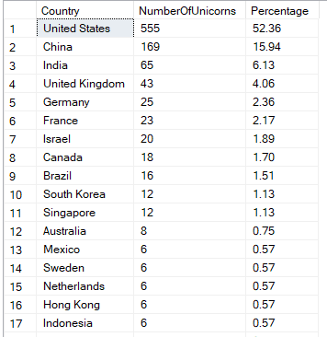
DATA EXPLORATION
4. Which countries have the most unicorns?
⇒ It is interesting (but not surprising) that the United States has the largest share of unicorns.
⇒ China and India, the countries with the largest share of the world population, have 15 and 6 percent share of unicorns, respectively.

Slide 21
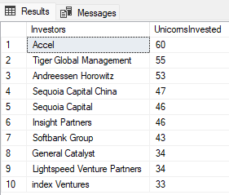
DATA EXPLORATION
5. Which investors have funded the most
unicorns?
⇒ This query output shows Accel is the top investor who invests in 60 unicorns.
⇒ Based on this project’s scope, Sequoia Capital and Sequoia Capital China are treated as different investors since we will not dive deep into further details.

Slide 22
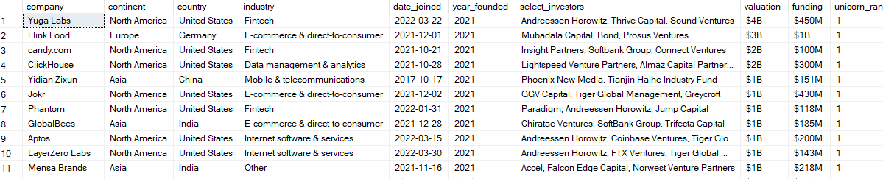
Ranking By Year Founded

Slide 23
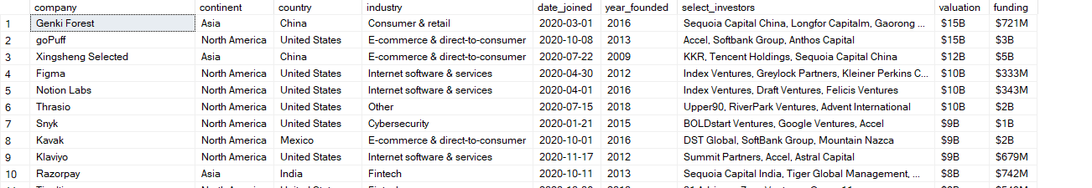
Companies That Become Unicorn In Year 2020 only

Slide 24
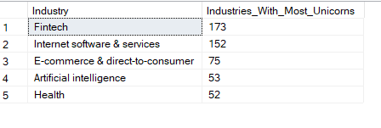
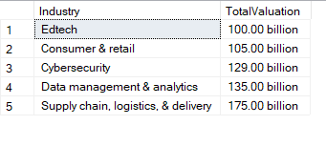
Industries With Most unicorns
Industries With Evaluation

Slide 25
First Unicorn Company
Last Unicorn Company

Slide 26
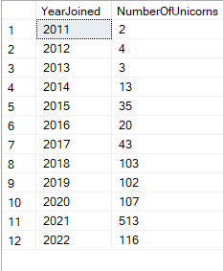
Number of Unicorn Companies In Each Year
2022 has the most number of unicorns produced,
while 20011 has only two

Slide 27
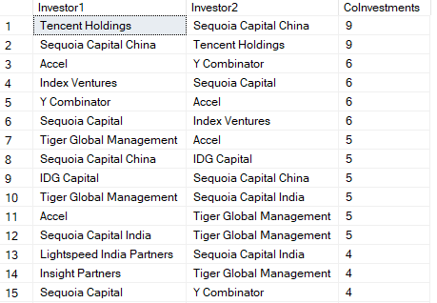
Common Investors Between Unicorns
We see that Tencent Holding & Sequoia Capital China have mutually invested in 9 Unicorn Together

Slide 28
2. ANALYSIS USING PYTHON

Slide 29
3. DATA VISUALIZATION (TABLEAU)
Techniques that I utilized in this project are:
Parameters
Top N filters
Reference lines
Calculated fields

Slide 30
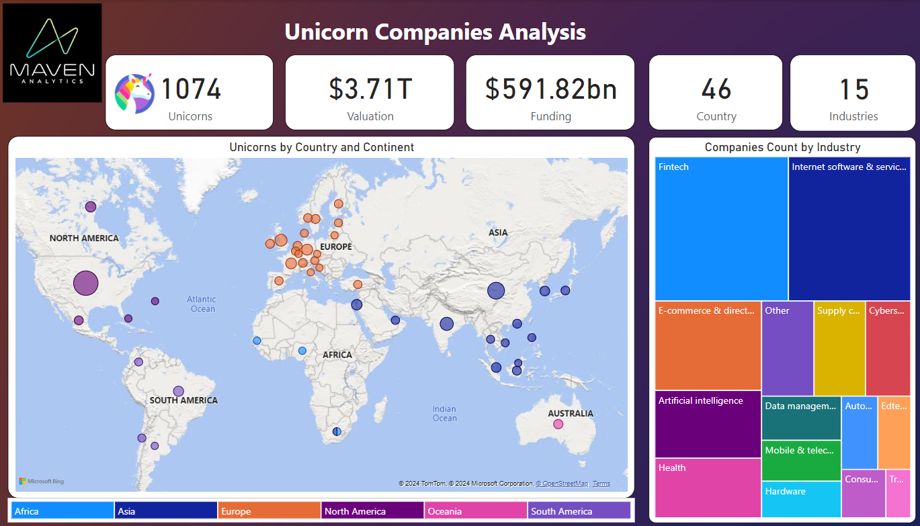

Slide 31
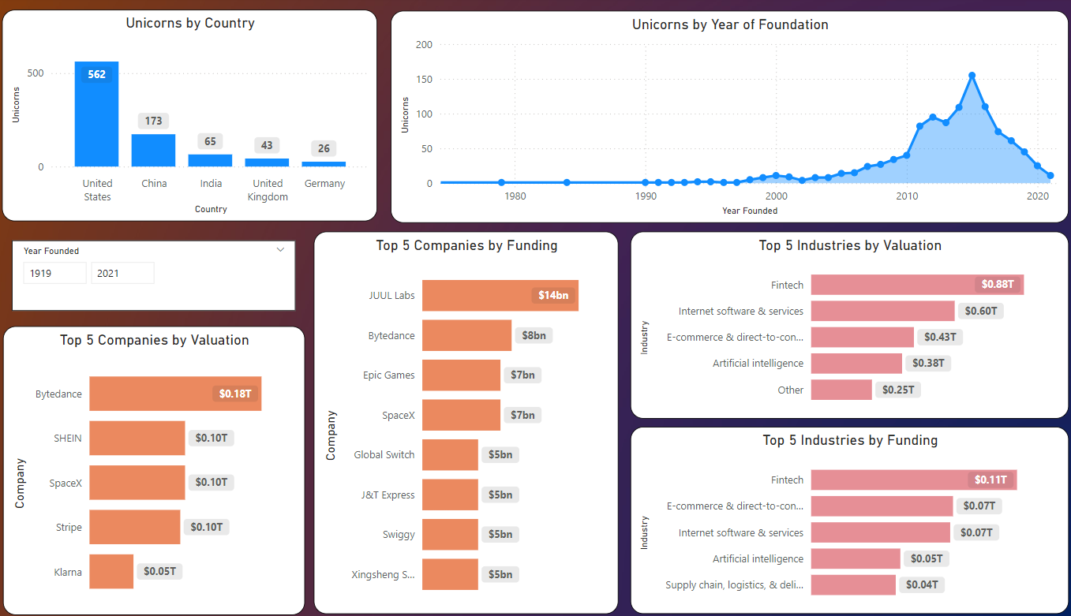

Slide 32
4. WEB PAGE
Techniques that I utilized in this project are:
CSS
HTML
FLASK
PYODBC
Render_Template

Slide 33
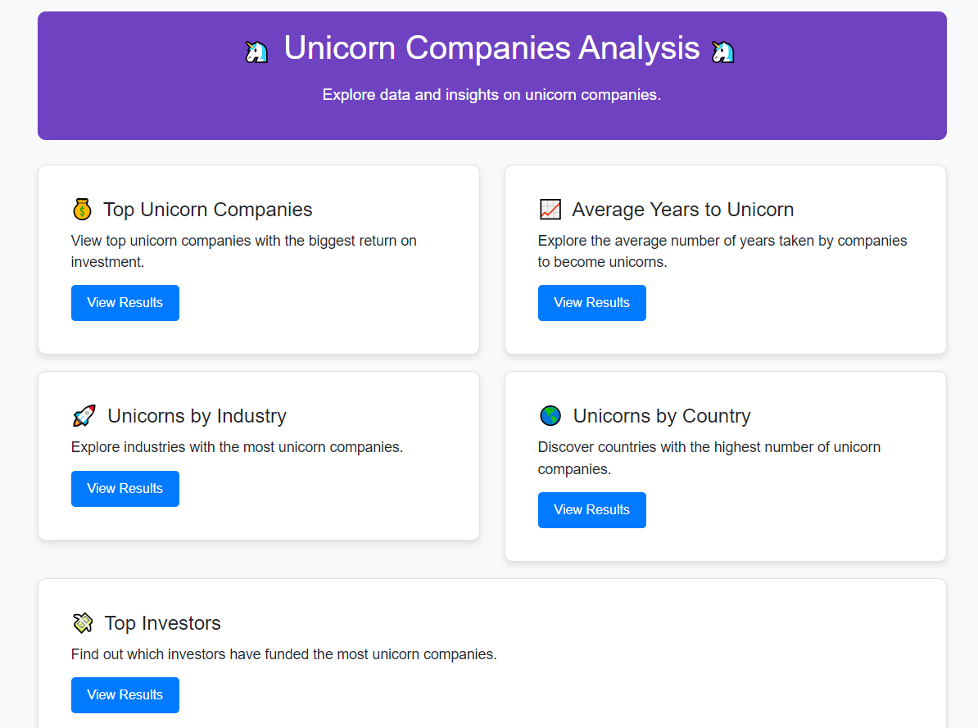

Slide 34
THANK YOU FOR VIEWING MY WORK!

